Slide 1

BASELINE PRESENTATION
Presented by:
Ing. Daniel Eduardo Zipa Barrero
Class:
Software configuration management

Slide 2
CONTENT
INTRODUCTION.
FUNCTIONAL REQUIREMENTS AND ANALYSIS.
NON-FUNCTIONAL REQUIREMENTS AND ANALYSIS.
DESIGN OF THE SYSTEM.

Slide 3
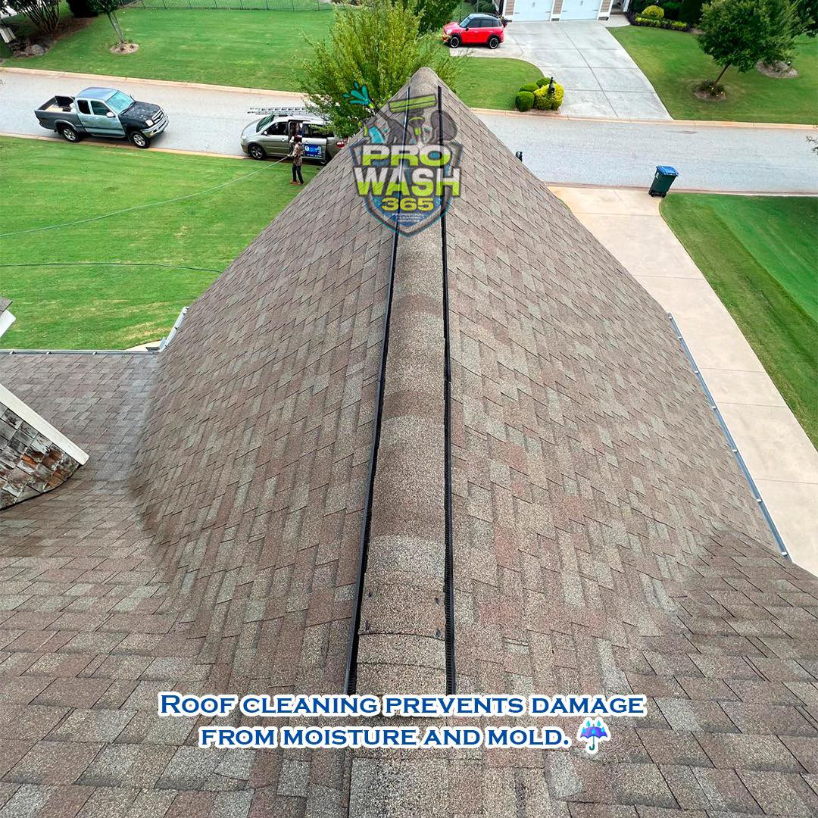
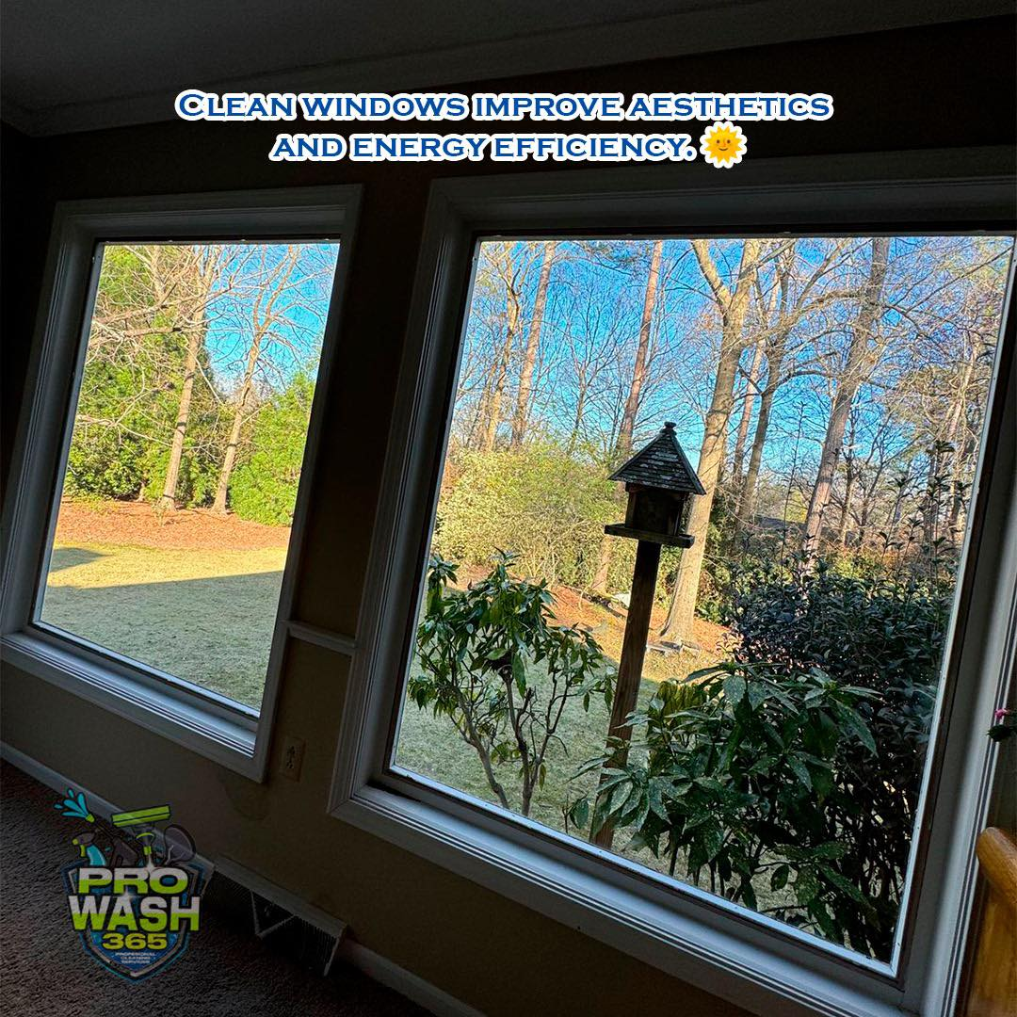

INTRODUCTION
Company dedicated to providing interior and exterior house cleaning services.
1

Slide 4
FUNCTIONAL REQUIREMENTS and analysis
User Management (1-12).
House Management (13-15).
Services and Memberships (16-19).
Service Request and Management (20-27).
Mobile Application Advertising (28).
Administrative Management (29-50).
2

Slide 5
Non-Functional Requirements
Performance.
Security.
Usability.
Availability.
Scalability.
Integration.
Maintainability.
3

Slide 6
DESIGN OF THE SYSTEM.
4

Slide 7
ACTORS
User (client).
Administrator.
External Payment System.
Messaging Services.
5

Slide 8
THANKS!

